Slide 1
Commencement of Poll
The poll should commence at the appointed time.
If commencement not done at the appointed hour, explain reasons for the delay in your Presiding Officer’s Diary.

Slide 2
COMMENCEMENT OF THE POLL – AT A GLANCE
Commencement of Poll at appointed time
Warning about Secrecy of vote
If delay in polling, entry in PrOs Diary
Precaution for indelible ink
Demonstrate marked copy of Electoral Roll to Polling Agents
Showing Register of Votes in Form 17 A to Polling Agents
Entry of Voters to Polling Station

Slide 3
Dos and DONTs
Treat all parties and candidates equally
Decide fairly and justly every disputed point
Your tact, firmness and impartiality are the most important safeguards against any breach of the peace.
Neither you nor any other officer at polling station should do any act or activity, interpreted as furthering the prospects of any candidate at the election.
You and other officers should maintain decorum and dignity.
Should not shake hands or get self photographed with a celebrity or VIP visiting polling station for casting his/her vote.

Slide 4
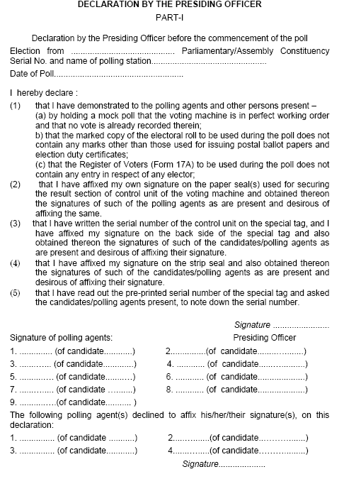
Read out the Prescribed Declaration

Slide 6
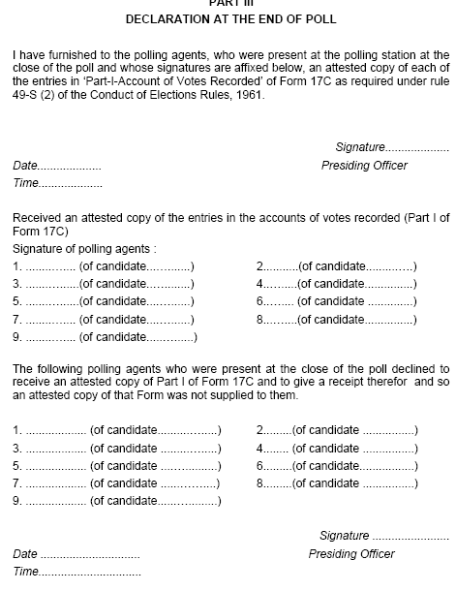

Slide 7
WARNING ABOUT SECRECY OF VOTING:
Before commencing poll, explain all the contesting candidates or their polling agents, the provisions of Section 128 of the Act regarding their duty to maintain the secrecy of the vote

Slide 8
Precautions for indelible ink
Polling Officer in-charge to take adequate precautions regarding indelible kept carefully
Ink does not get tilted and the ink spilt during the poll.
Take some sand or loose earth or an empty tin or some broad-bottomed vessel, and push the phial down three-quarters of its length into the centre
Ensure the plastic rod attached to the cork is left/kept standing and not taken out except for marking the voter’s forefinger.
The rod should always be held with its marking end pointing vertically downwards.

Slide 9
Marked copy of the electoral roll
Ensure to demonstrate to the contesting candidates/polling agents that the marked copy of the electoral do not contain any remarks other than issuing postal ballot papers, EDC and CSVs and that the deletions appearing in the supplement are appended to the draft roll and supplements prepared after disposal of claims
Objections before final publication reflected in the reprinted mother roll by strikethrough method in the electoral roll of eight columns without photograph
Word ‘DELETED’ superimposed on elector detail box in case of photo electoral roll
No other entry is deleted or altered or omitted

Slide 10
Register of voters in Form 17 A
Show to the contesting candidates/polling agents the Register of Voters reflecting no other entries other than entries of each elector No. allowed to vote with his signature/thumb impression.

Slide 11
Entry of voters to Polling Station to be regulated
Infirm voters and women voters with babies in arms given precedence over others
Ensure physically challenged electors given priority without waiting in the queue with facility to take wheel chair inside the polling station
Special care to electors with speech and hearing impairment
Entry to the electors

Slide 12
Ensure implementation of instructions regarding
Demonstration of the voting machine,
Marked copy of the electoral roll and Register of Voters
Obtaining signatures of the contesting candidates/polling agents on the green paper seal
Allowing them to note down their serial numbers
Read out the declaration for all persons present in the polling station
Sign the declaration and obtain signatures of the contesting candidates/polling agents
Any polling agents decline to affix their signatures, their names should be recorded.

Slide 13
Enforcement of Election Law in and around polling station
Ban on canvassing:
Canvassing within 100 meters of the polling station is an offence under the election law.
Any person doing so will be arrested without warrant by the police and may be prosecuted under section 130 of the Representation of the people Act. 1951

Slide 14
Enforcement of Election Law in and around polling station
Candidate’s election booth:
Contesting candidates can set up election beyond 200 meters from the polling station, to help the electors locate their names in the electoral roll.
The candidates are provided one table and two chairs for agents and workers for the distribution of unofficial identity slips to voters beyond a distance of 200 meters from the polling station with an umbrella or a piece of tarpaulin.
If any violation of instructions, report to the Sector Magistrate or other officials responsible for maintenance of law and order around your polling station.

Slide 15
Enforcement of Election Law in and around polling station
Disorderly conduct in or near the polling station
Police can arrest and prosecute any person behaving disorderly only when persuasion and warning have proved ineffective.
Steps should be taken to stop use of a megaphone or loudspeaker interferes with the work without any prescribed limit of distance under section.

Slide 16
Removal of trouble makers
Any person who misconducts may be removed from the polling station on your orders by any police officer or other persons authorized by you.

Slide 17
Removal of voting machine from polling station to be an offence if any person, fraudulently or unauthorized takes or attempts willfully to take a voting machine out of a polling station:
Commits a cognizable offence punishable with imprisonment upto one year or
With fine upto five hundred rupees or
With both

Slide 18
Breach of official duty by election officers
Without reasonable cause, he commits a cognizable offence.

Slide 19
Who can Enter the Polling Station?
The polling officers
Each contesting candidate, his election agent and one polling agent of each candidate
Persons authorized by the Commission such as media persons issued with authority letters
Public servants on duty
A person accompanying or assisting a blind or an infirm voter who cannot move or vote without help

Slide 20
Prohibition of going armed to or near a polling station
No person other than the Returning Officer, Presiding Officer, any police officer and any other person is appointed to maintain peace and order.
If any person contravenes, the offence is cognizable and liable to imprisonment for a term, which may extend to two year or with fine, or both.

Slide 21
Prohibition of use of cellular phones, cordless phones, wireless sets etc in the polling station.
As per the standing instructions of the Commission, no cellular phones, cordless phones, wireless sets etc., will be allowed inside the polling stations and not even around 100 meters radius of the polling stations.

Slide 22
1st Polling Officer
In-charge of the marked copy of the roll
Identification of voters
Challenged voters, if any

Slide 23
What can be ignored in case of challenge of voter’s identity?
Discrepancies such as elector's name, father's/mother's/husband's name, sex, age (only within 2/3 years) or address in the electors photo identity card shall be ignored provided identity is established.
Discrepancy in the serial number of the electors photo Identity card as mentioned in the electoral roll shall be ignored
An elector with photo identity card issued by Election Registration Officer of another assembly constituency shall be allowed provided the name is there in electoral roll

Slide 24
List of dead, absent and allegedly bogus voters
If any name is mentioned in one of above categories and the person appear for voting, check the list provided by polling agent or contesting candidate and ensure the existence of person through formal identification procedure as other voters

Slide 25
Challenged Voters
The polling agents can also challenge the identity of a person.
He need to deposit Rs.2 (Rupees two only) in cash with you for each such challenge
You need to do inquiry of the same
Furnish receipt of the same

Slide 26
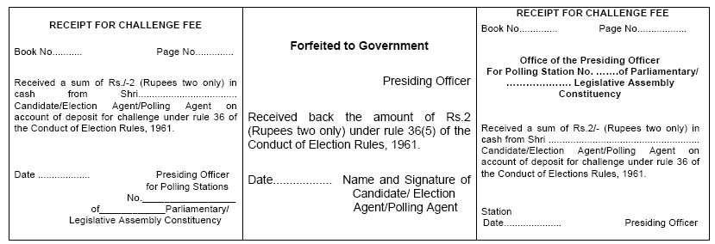
Procedure in case of challenge

Slide 27
Procedure in case of challenge
Warn the person challenged about the penalty for personation
Enter his name and address in the list of Challenged Votes (Form 14)
Ask him to sign/ affix his thumb impression
If he refuses to do so, do not allow him to vote

Slide 28
Procedure in case of challenge
Ask the challenger to produce evidence that he is not voter
If he does not provide prima facie evidence – disallow challenge
If prima facie evidence provided, ask the voter to produce evidence that he is voter (Rebut the challenge)
If voter proves his point, allow him for voting
If he fails, hold the challenge proved

Slide 29
Verification of Elector’s Identity and procedure in case of challenge
Take support of villagers if you need to ascertain the fact
Administer oath from challengers
Enter the name in LIST OF CHALLANGED VOTES
Immediately return the challenge fee of two rupees to the challenger after inquiry except if you find that the challenge was not done in good faith.
In that case forfeit the challenge fee to Government and do not return it to
the challenger and enter the word “forfeited” in Column 10 of Form 14 and the relevant counterfoil in the receipt book

Slide 30
Procedure in case of challenge

Slide 31
Declaration of age
Minimum voting age
Person having identity as voter can not be questioned in any case
In case s/he does not appears below 18 years, as per your view:
Inform him about penal provision in section 31 of the Representation of the People Act, 1950, for making false declaration.
Obtain a declaration, as in form, that elector about his age on the 1st day of January of the year
Prepare a list of such voters.

Slide 32
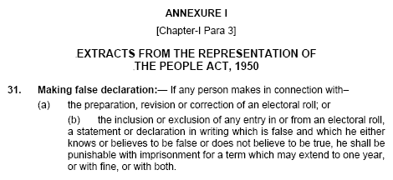

Slide 34
2nd Polling Officer
Indelible Ink
Form 17A
Voter slip

Slide 35
Application of Indelible ink
Inspection of voter’s left forefinger and application of indelible ink
The second Polling Officer shall mark the elector’s left hand forefinger with indelible ink
Remove oily or greasy substance on forefinger if any
Application of indelible ink at fresh poll/ re-poll/ Countermanded poll
At the time of fresh poll/ re-poll/countermanded poll, the marking with indelible ink made during original poll should be ignored and fresh marking with indelible ink is done
In case of elector with no left forefinger
Apply indelible ink on any finger on left hand
If no finger on left hand apply indelible ink on right hand forefinger
If no forefinger on right hand then apply ink on any finger on right hand
If no finger on either hand apply indelible ink on extremity ( Stump) on left or right hand

Slide 36
Record of electoral roll number of elector in Register of Voters (Form 17A) and obtain Signature or Thumb impression of voter
In column (1) of the register of voters, the second Polling Officer will write down the serial numbers of electors in consecutive order, starting with serial number 1
In column (2) of the said register, the second Polling Officer will write down the electoral (serial ?)roll number
A signature may be described as the writing of a person’s name on a document with the intention of authenticating that document.

Slide 37
S.No. | Electoral roll No. i.e. S. No. of the elector in the marked copy of the roll* | Signature/ Thumb Impression of elector
1
2
3
4
5
6
7
8
9
10
*For example, if the name of the first elector who comes to vote at the polling station at the commencement of poll is entered at serial number 756 in the marked copy of the electoral roll, the Second Polling Officer will write down serial number 756 in the second column against serial No. 1 in the first column of the register of voters. Likewise, if the second voter's name is entered at serial number 138 in the electoral roll, the second Polling Officer will write serial number 138 in column 2 against serial number 2 in column 1 of the register, and so on.

Slide 38
When not allowed to vote
Literate Voter
The preferable course in the case of a literate voter will be to request him to sign his name, i.e., both his name or names and his surname in full.
Only mark can not be considered as signature in case of literate voter
If literate person refuse to sign in full, his thumb impression should be taken
If he refuse to put sign or thumb impression he should not be allowed to vote

Slide 39
Record of electoral roll number of elector in Register of Voters (Form 17A)/ Signature or Thumb impression of voter
Illiterate voter
Clear thumb impression is essential. After thumb impression wipe off the ink from thumb
*Companion will put sign/ thumb impression
Unable to sign |  | impression of left hand thumb
No left hand thumb |  | impression of right hand thumb
Both hands thumbs missing |  | impression of one of the finger on left hand starting from the fore finger
No left hand finger |  | impression of right hand finger starting from the forefinger
No fingers |  | voters seek assistance of companion (under rule 49 N)*

Slide 40
Case of differently-abled voters
Thumb impression on the register of voters by blind or infirm or leper electors, who are illiterate but can use their hand
Literate person should be allowed to put signature by writing name
In case of infirm voters, who cannot use either of their hands, the companion should sign or put thumb impression
A note may be made against each such entry

Slide 41
Issue of voter’s slip to elector
Serial number of elector as per Col (1) of register of votes…..
Serial no. of elector as entered in the electoral roll……
Initials of polling officers………………….
50 or 100 slips bundle in required number is given to you as part of polling material

Slide 42
3rd Polling Officer
1. Collect the voter slip
2. Check the finger for indelible ink
3. Authorize the elector to vote
4. Keep the voter slip safely

Slide 43
Permitting elector to vote
After elector comes with the voter's slip, the Third polling officer in-charge will take the voter's slip from him, check his finger for ink and allow him to vote.
All voter’s slips will be preserved and kept after sealing in a separate cover
After the voter slip is collected from the elector, his left forefinger shall be checked by you/third polling officer in-charge and the elector will be directed to record his vote.

Slide 44
Voting procedure using EVMs
The ballot unit(s) has to be activated by you/third polling officer in-charge by pressing that unit, the 'Busy' lamp will glow red and simultaneously the 'Ready' lamp will start glowing green
The elector will record his vote by pressing the 'Blue Button ’on the ballot unit against the name and symbol of the contesting candidate of his choice.

Slide 45
Voting procedure using EVMs
When he presses that button, the lamp on the ballot unit against the name and symbol of that contesting candidate will start glowing red and green light on the ballot unit will go off.
A beep sound will be heard from the control unit.
After a few seconds, the beep sound and the red light in the candidate's lamp on the ballot unit and the red light in the 'Busy' lamp on the control unit will go off.
Ensured that after an elector records his/her votes, the 'Ballot' button on the control unit is pressed for the next voter only when the earlier voter has come out of the voting compartment.

Slide 46
Tallying of number of votes polled periodically
Pressing 'Total' button on the control unit will show the total number of votes polled by that time.
Periodically tally should be done with the number of electors allowed to vote reflecting in the register of voters.
Tally the number of votes polled every two hours interval and record in the Presiding Officer's diary.
The 'Total' button should be pressed only when the busy lamp is not on, i.e. only after the elector recorded his vote, and before the next elector is allowed to vote by pressing the Ballot button.

Slide 47
Presiding Officer's right to enter the voting compartment during poll
If the ballot unit kept in the screened voting compartment is not functioning properly
If an elector entered the voting compartment is tampering with or otherwise interfering with the ballot unit
If elector has committed any mischief by pasting any paper, tapes etc., on the symbol/names/ballot button
If elector has remained inside the voting compartment for unduly long period.
Presiding Officer to enter the voting compartment in presence of the polling agents.

Slide 48
Complex situations on the poll day
Challenge to a voter (Chapter XVIII of the Presiding Officer’s Handbook),
Voting by minors (Chapter XVIII),
Voting by blind or infirm voters (Chapter XXII),
Voters deciding not to vote (Chapter XXIII),
Tendered votes (Chapter XXVII),
Breach of secrecy of voting (Chapter XXI),
Disorderly conduct at the booth and removal of disorderly persons (Chapter XVII),
Adjournment of poll because of riot or any other cause (Chapter XXVIII).

Slide 49
Refusal to observe Voting Procedure
If the elector refuses to observe voting procedure after warning by you/polling officer even after issue of voter's slip, slip should be withdrawn from him and cancelled.
A remark that– “Not allowed to vote – Voting procedure violated”- in the remarks column in the Register of Voters (Form 17A) against the entry relating to that elector by you.
You shall put your full signature below that entry.
No change to be done in the serial number of that elector or of any succeeding elector in column (1) of the register of voters.

Slide 50
Voting by blind and infirm voters
Voting by blind and infirm voters
If you are satisfied that an elector is unable to recognize the symbol on the ballot paper due to blindness or is unable to record his vote by pressing the appropriate button without assistance due to some physical infirmity, you shall permit that elector with him a companion of not less than 18 years of age to the voting compartment for recording the vote on his behalf and in accordance with his wishes
Before helping such person to cast vote, the companion needs to make declaration as given in next slide- secrecy of vote and that he has not accompanied more than one person

Slide 51
Voting by blind and infirm voters

Slide 52
Voting by blind and infirm voters
No person shall be permitted to act as a companion of more than one elector at any polling station on the same day
You shall keep a record of all such cases in Form 14A.
This record of blind and infirm voters in Form 14A will be kept in a packet super scribed as “NON-STATUTORY COVERS”
None of your polling staff acts as a companion to the blind elector

Slide 53
Voting by Public servants on duty
As a policy, no person will be assigned polling duties in his home constituency.
Public servant on election duty have the option of casting their votes through postal ballot system
They will have to apply to the Returning Officer in Form 12
The District Election Officer/Returning Officer will send you sufficient number of Forms 12 to enable you and the Polling Officers to apply for Postal Ballot Papers
The Returning Officer will make arrangement to facilitate their voting and depositing the ballot paper and the connected papers at the training centre itself

Slide 54
Voting by Public servants on duty
Some female polling officers who are voters may be posted in their home constituency
They may have been granted EDC (Election Duty Certificate).
In their cases they will vote personally at the polling station where they are/would be posted on election duty
If for any reason, their duties is cancelled they should not be deprived of the right to exercise their vote. They can vote on any Polling Station other than the PS where his/her name is registered.

Slide 55
Voting by Public servants on duty
An election official or any other public servant on election duty, to whom an EDC has been issued, should be allowed to cast his/her vote at any polling station other than the one in for which EDC is obtained including the polling station where he/she was originally posted for duty
Applications from voters on election duty to vote by postal ballot are required by law to be made at least seven days in advance
The Returning Officer may decide before the day of poll or the first day of the poll in the constituency

Slide 56
Voting by proxy
Some categories of service voters have been given the facility of voting through proxy appointed by them.
Such voters are categorized as “Classified Service Voters” (CSVs).
The Returning Officer will supply you a list of the CSVs
This list of CSVs is to be treated as part of the marked copy of the electoral roll for your polling station

Slide 57
Voting by proxy
Proxy voter will follow the same procedure as other voters
In the case of proxy, marking of indelible ink will be done on the middle finger of the left hand
The proxy will be entitled to vote on behalf of the CSV in addition to the vote that he may cast in his own name if he is registered elector in the constituency
The serial number of elector to be entered in the second column of the Register of Electors (Form 17A) as given in the sub-list of CSVs for your polling station.
In the main marked copy of the electoral roll, the letters ‘PV’ (for ‘Proxy Voter’) should be suffixed in bracket.

Slide 58
Design of tendered ballot paper
Tender voters means some one whose identity has been established through verification of documents as per rules but some one has already voted in his name.
The Returning Officer will provide to each polling station 20 additional ballot papers to be used as tendered ballot papers
Before giving it to voters, write "Tendered Ballot Paper" on the back of these ballot papers in your own hand, if not already stamped as tendered ballot papers

Slide 59
A/C of Tendered votes
Account of tendered ballot paper & Record of tender voters
keep a correct account of all ballot papers * received for use as tendered ballot papers
A/C of ballot papers issued as such to electors, and not used and returned, in Item 8 of Part I of Form 17C
Maintain complete record of the electors who have been issued with tendered ballot papers, in Form 17B.
Obtain the signature or thumb impression of the elector in Column (5) of that Form before delivering a tendered ballot paper to him

Slide 60
Recording of votes on tendered ballot paper
Supply an inked arrow cross mark rubber stamp
The elector concerned will mark his vote on the ballot paper by putting the cross mark on or near the symbol of the contesting candidate of his choice by means of the arrow cross mark rubber stamp
The elector will then fold the tendered ballot paper and hand it over to you
Keep all the tendered ballot papers and the list of such tendered ballot papers prepared in Form 17B in a cover provided for the purpose and seal the cover at the close of the poll
In case of blindness or physical infirmity companion shall be permitted

Slide 61
Electors deciding not to vote
If an elector, after his electoral roll number has been duly entered and put his signature/thumb impression and decides not to record his vote
He shall not be forced or compelled to record his vote
Remark Refused to vote in register against his name and put your signature
Obtain signature or thumb impression of the elector against such remark under rule 49O
If voters decide after ballot button on control unit is pressed, direct the next voter to voting compartment

Slide 62
Electors deciding not to vote
If the “Ballot” button on the control unit has been pressed to release voting on the ballot unit for the last elector but he refuses to vote then
Whoever is in-charge of the control unit shall put the ‘Power’ switch in the rear compartment of the control unit to ‘OFF’ position
Disconnect the ballot unit(s) from the control unit.
After disconnecting the ballot unit(s) from the control unit the ‘Power’ switch should again be put ‘ON’.
Now the ‘Busy’ lamp will go off and the ‘Close’ button will become functional to close the poll.
Do it care fully and step wise as if this whole process is not followed in such a case, the ‘Close’’ button will not be functional and without closing the control unit, it will not give the result, because the ‘Result’ button will also become functional only after the ‘Close’ button is pressed.

Slide 63
Electors deciding not to vote
Signature/thumb impression
Electoral Roll No.
Not to Vote
Elector decides
Forced to vote
Marked Refuse to Vote in Register
Signature/thumb impression of elector (Rule 49Q)
Signature of PrO
If Ballot Button press!
‘Busy’ lamp off
POWER Switch “OFF”
Ballot Unit
Power Switch “ON”
Disconnect
‘Close’ button Functional

Slide 64
Adjournment /Stoppage of Poll
The Presiding Officer is empowered to adjourn the poll
Under section 57 (1) of the representation of The People Act 1951
A natural calamity like flood, heavy snowfall, a severe storm, or
Non-receipt or loss or damage to essential polling materials like voting machine, authentic copy of electoral roll and the like
Disturbance of peace at the polling station making it impossible to take the poll, or

Slide 65
Adjournment /Stoppage of Poll
The Presiding Officer is empowered to adjourn the poll
If there is a riot or any attempt of open violence, police force to be used to control and if cannot be controlled and impossible to continue the poll, you should adjourn the poll.
A passing shower of rain or strong wind would not normally be a sufficient cause for adjournment of poll.
The Commission has decided that an adjourned poll may be ordered at the polling stations where polling fails to start within two hours of the time scheduled for the commencement of poll.
In case of adjournment of poll, you must report immediately the full facts to the Returning Officer

Slide 66
Adjournment /Stoppage of Poll
The Presiding Officer is empowered to adjourn the poll
Wherever a poll is adjourned, formal announcement to all present at the polling station, that the poll will be taken on a day to be notified subsequently by the Election Commission.
Both the units of the voting machine and all election papers should be sealed and secured in the presence of the polling agents as if the poll has come to a close in the normal way.
Non-arrival of the polling party at the polling station due to obstruction on the way or any other serious difficulty
Any other sufficient cause.

Slide 67
Adjournment /Stoppage of Poll
Completion of adjourned poll.
The adjourned poll will recommence on the date and time fixed by the Election Commission from the stage at which it was left immediately before the adjournment,
The electors, who have not voted before the poll was adjourned, will alone be permitted to vote at the adjourned poll.
The Returning Officer will provide the Presiding Officer with the sealed packets containing the same marked copy of the electoral roll and the register of voters in Form 17A, which were earlier used at that polling station, and a new voting machine.

Slide 68
Adjournment /Stoppage of Poll
Completion of adjourned poll.
The sealed packet containing the marked copy of the electoral roll and the register of voters should be reopened by you in the presence of the contesting candidates or their agents, and this marked copy of the electoral roll and the register of voters should be used for completion of adjourned poll.
The provisions of rules 28 and 49A to 49B will apply to the conduct of an adjourned poll also as they apply to the poll before it was so adjourned.
Where the poll could not be commenced due to non-arrival of the polling party or other reasons, the provisions of abovementioned rules will apply to every such adjourned poll as they apply to the original poll.

Slide 69
When Election is declared void?
The Election Commission has been given power to declare the poll to be void and direct a fresh poll, if at that polling station
Any voting machine has been unlawfully taken away by any unauthorised person, or
Any voting machine has been accidentally or intentionally destroyed or lost or damaged or tempered with and the result of the poll at that polling station cannot be ascertained for that reason, or
Any voting machine develops a mechanical failure during the course of the recording of votes, or
Any error or irregularity in procedure, which may vitiate the poll, has been committed, or
There has been booth capturing

Slide 70
Fresh Poll
The Election Commission has been given power to declare the poll to be void and direct a fresh poll, if at that polling station
If any such thing happens at your polling station, you should report to the Returning Officer, who will, in turn, report the matter to the Election Commission for its directions.
After considering all material circumstances, if the Commission directs fresh poll, such fresh poll shall be taken in the same manner as the original poll.
All electors entitled to vote at the polling station will be entitled to vote again at the fresh poll. The marks of the indelible ink made at the original poll should be ignored at the fresh poll.
The Commission has directed that the mark of the indelible ink, in case of a fresh poll, should be put on the voter’s left hand middle finger to distinguish the marks to be made at the fresh poll.

Slide 71
Booth Capturing
Closing of voting machine in the case of booth capturing
Where the Presiding Officer is of the opinion that booth capturing is taking place at the polling station, he shall immediately push the close button in the control unit of the voting machine under Rule 49X of the conduct of Elections Rules 1961.
Closing the voting machine should only be done when you are certain that the booth capturing is taking place and not on a mere apprehension or suspicion
Once the control unit is closed, the voting machine will not record any votes and the poll will have to be necessarily adjourned either for the day or temporarily till the new voting machine is provided.
Immediately report the matter to the Returning Officer.
The Returning Officer shall, in turn, report the full facts to the Election Commission through the fastest means of communication available.

Slide 72
Booth Capturing
The Election Commission, on receipt of the report from the Returning Officer may
Either decide to have the adjourned poll by providing a new voting machine, if it is satisfied that the poll upto that stage was not vitiated, or
Declare the poll as void, if it is satisfied that the poll was vitiated, and direct a fresh poll at that polling station.

Slide 73
Ensure implementation of instructions regarding: Procedure to be followed at the time of use of new voting machine.
Read declaration.
At the end of the poll, record a further declaration
Declaration to be put in separate packet and delivered to Returning Officer with the account of votes recorded and the paper seal account in Form 17C.

Slide 74
Complaints of Illegal hiring of vehicles for the conveyance of voters
If any complaint received about illegal conveyance of electors from their homes and back, action can be taken to prosecute the offender Or the facts can be used as a ground for filing an election petition against him.
Forward any complaint filed with remarks made from own observation and personal knowledge to
Sub-divisional
Zonal/Sector Magistrate
Follow the instructions/directives issued by the Election Commission regulating the plying of vehicles on the day of poll.

Slide 75
THANKS

